Slide 1

Z.O.O
Jiaziruo Sun, Shuheng Wang, Xiaoman Lin, Xinyin Zhang

Slide 2
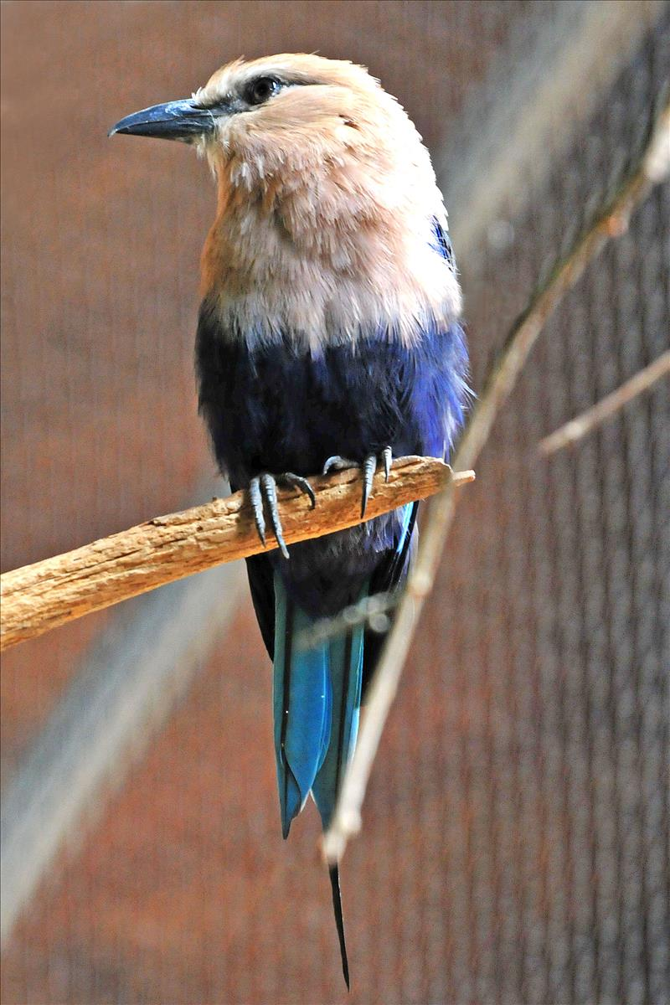
What are we creating? Why?
Create a systematic database “Z.0.0” for Tonronto Zoo, the largest zoo in Canada
Store and update animals’ and employees’ archives
Track visitors’ information and booking state
Image from torontozoo.com

Slide 3
Entities
Employee
Animal
Department
Visitor
Service
Payment method
Ticket (weak)

Slide 4
Attributes
Employee
Name (composite)
First name
Middle name
Last name
Birthday (composite)
Year
Month
Day
Address (composite)
Street name
Street number
Postal code
Contact information (composite)
Email
Phone number
Salary
Age(derived)
Gender
ID (key)
Job_type
Animal
Name
Age
Sex
Species
Preference (multivalued)
Diet
Environment
Domain
Quantity(derived)
ID (key)
Department
Department code (key)
Phone

Slide 5
Attributes
Service
Opening hours (multivalued)
Phone number
Service Num (key)
Visitor
Name (composite)
First name
Middle name
Last name
ID (key)
Age (derived)
Payment method
Ticket
Price
Ticket ID (key)
Overdue date (composite)
Day
Month
Year
Type

Slide 6
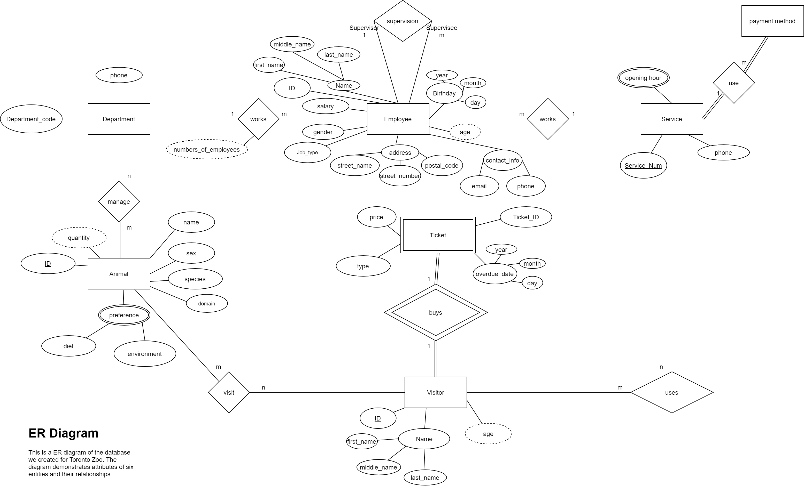
ER Diagram

Slide 7
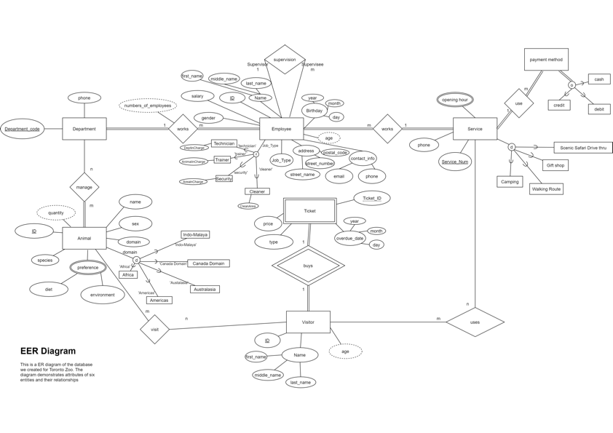
EER Diagram

Slide 8
Physical Database Design

Slide 9
Conclusion
Goal: build a manage system for Toronto Zoo to store and track information
Problem countered: -make choices of entities and attributs
-different time zones
How to solve: held online meetings and share screens while discussing
Future problem: difficulty with extracting data, filtering data. programming

